Slide 1

UNIVERSITY INSTITUTE OF ENGINEERING
DEPARTMENT OF COMPUTER SCIENCE AND ENGG.
Bachelor of Engineering (Computer Science & Engineering)
DATA STRUCTURES
DISCOVER . LEARN . EMPOWER

Slide 2
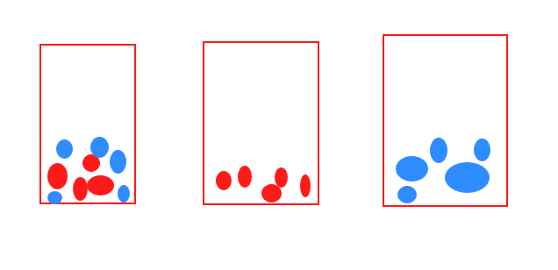
What is Data Structure?
Data structure is
a way to store and organize data in particular order
It facilitates the access and modifications
For example, we can store balls of same color in the same box, so that it becomes easier for us to find and use them

Slide 3
Need of Data Structures
As applications are getting complexed and amount of data is increasing day by day, there may arise the following problems:
Processor speed: To handle very large amount of data, high speed processing is required, but as the data is growing day by day to the billions of files per entity, processor may fail to deal with that much amount of data.
Data Search: Consider an inventory size of 106 items in a store, If our application needs to search for a particular item, it needs to traverse 106 items every time, results in slowing down the search process.
Multiple requests: If thousands of users are searching the data simultaneously on a web server, then there are the chances that a very large server can be failed during that process. in order to solve the above problems, data structures are used. Data is organized to form a data structure in such a way that all items are not required to be searched and required data can be searched instantly.

Slide 4
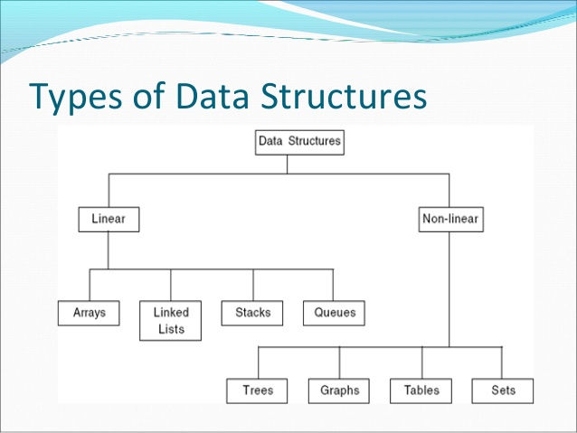
Data Type & Data Structure
Data type
Set of possible values for variables
Operations on those values
Ex : int, float, char ……….
Data Structure
A data structure is an arrangement of data in a computer's memory or even disk storage.
The logical and mathematical model of a particular organization of data is called a data structure.
A data structure is a particular way of storing and organizing data in a computer so that it can be used efficiently.

Slide 5
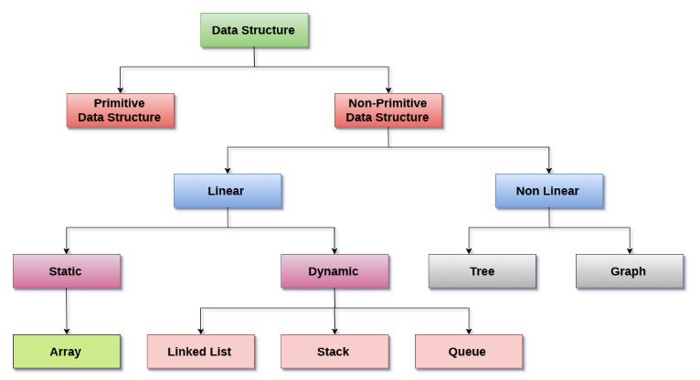
Type Of Data Structures

Slide 6
array
Linked list
queue
tree
stack

Slide 7
Types of Data Structure
Linear: In Linear data structure, values are arranged in linear fashion.
Array: Fixed-size
Linked-list: Variable-size
Stack: Add to top and remove from top
Queue: Add to back and remove from front
Priority queue: Add anywhere, remove the highest priority

Slide 8
Types of Data Structure-I
Non-Linear: The data values in this structure are not arranged in order.
Hash tables: Unordered lists which use a ‘hash function’ to insert and search
Tree: Data is organized in branches.
Graph: A more general branching structure, with less strict connection conditions than for a tree

Slide 9
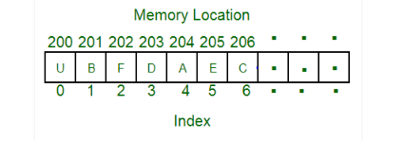
Array
collection of items stored at contiguous memory locations.
multiple items of the same type are stored together
easier to calculate the position of each element by simply adding an offset to a base value, i.e., the memory location of the first element of the array (generally denoted by the name of the array).

Slide 10
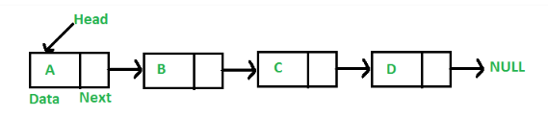
Linked List
A linked list is a linear data structure WHERE
elements are not stored at contiguous memory locations.
elements in a linked list are linked using pointers as shown in the below image:
Elements can be:
Inserted
Accessed
Deleted
At any position
last
first

Slide 11
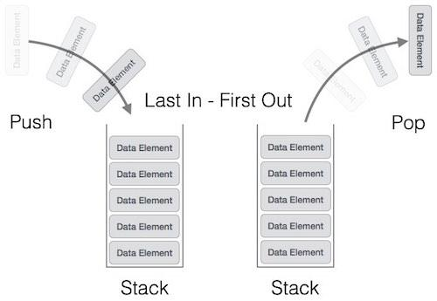
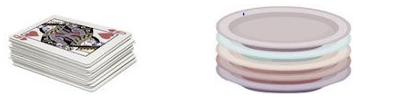
Stacks
Collection with access only to the last element inserted
Last in first out
insert/push
remove/pop
top
make empty

Slide 12
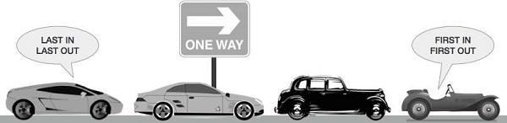
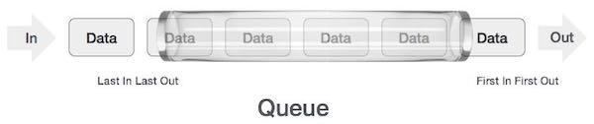
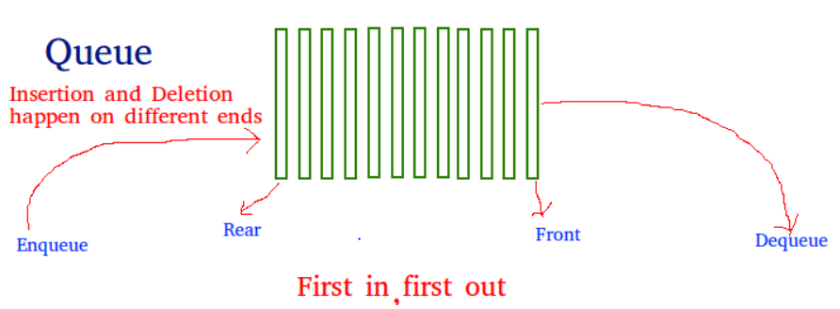
Queues
Collection with access only to the item that has been present the longest
Last in last out or first in first out
Enqueue, Dequeue, front priority queues
and dequeue

Slide 13
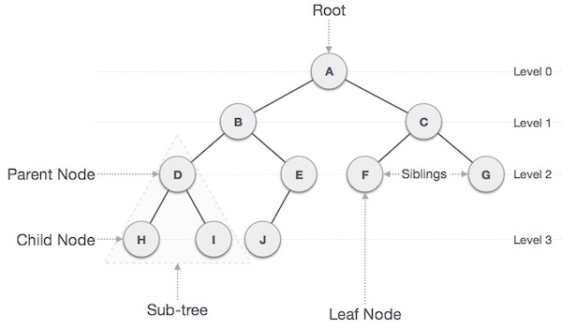
Tree
Non Linear type data structure
Tree represents the nodes
Following are the important terms with respect to tree.
Path, Root, Parent, Child ,Leaf

Slide 14
Learn about Complexities
The primary motive to use DSA is to solve a problem effectively and efficiently.
Complexity is of two types:
Time Complexity: Time complexity is used to measure the amount of time required to execute the code.
Space Complexity: Space complexity means the amount of space required to execute successfully the functionalities of the code. Auxiliary Space - refers to the extra space used in the program other than the input data structure.

Slide 15
Algorithm Complexity
Time-space tradeoff– The best algorithm , hence best program , to solve a given problem is one that requires less space in memory and takes less time to complete its execution. But in practice, it is not always possible to achieve both of these objectives.
Best case Complexity – The term best-case performance is used in computer science to describe an algorithm's behaviour under optimal conditions. For example, the best case for a simple linear search on a list occurs when the desired element is the first element of the list.
Average Case Complexity– The average-case complexity of an algorithm is the amount of some computational resource used by the algorithm, averaged over all possible inputs
Worst Case Complexity– The worst-case measures the resources (e.g. running time, memory) an algorithm requires in the worst-case. It gives an upper bound on the resources required by the algorithm.

Slide 16
Asymptotic notation is a mathematical tool that calculates the required time in terms of input size and does not require the execution of the code.
The following 3 asymptotic notations are mostly used to represent the time complexity of algorithms:
Big-O Notation (Ο) – Big-O notation specifically describes the worst-case scenario.
Omega Notation (Ω) – Omega(Ω) notation specifically describes the best-case scenario.
Theta Notation (θ) – This notation represents the average complexity of an algorithm.

Slide 17
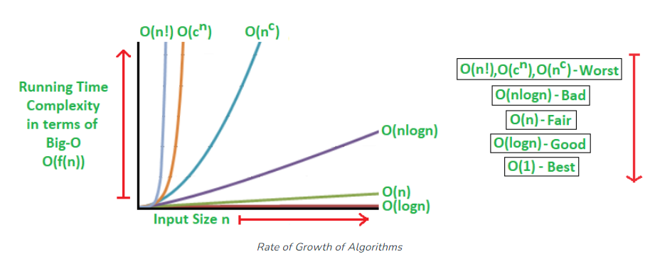

Slide 18
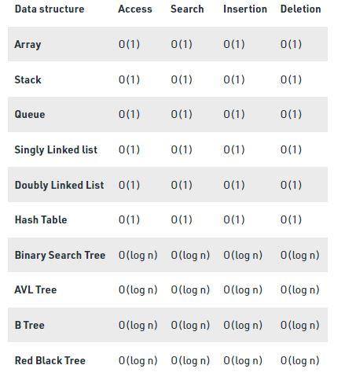
Best Case Time complexities of different data structures

Slide 19
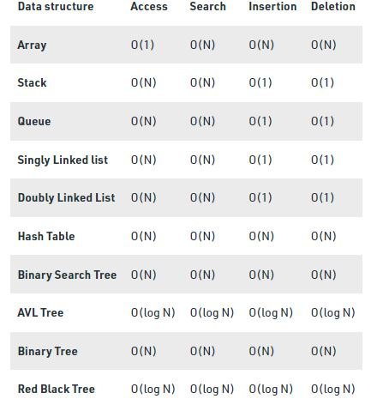
Worst Case Time complexities of different data structures

Slide 20
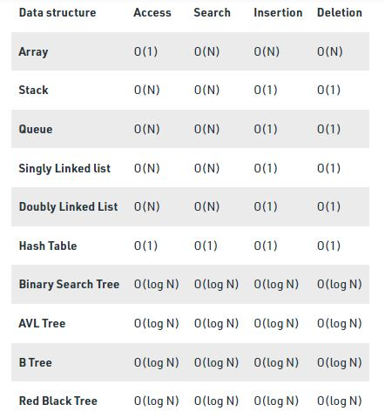
Average Case Time complexities of different data structures

